Slide 1
Malikca
A RPG Platforming game by Anthony Brown

Slide 2
RPG???
RPG stands for Role Playing Game
Usually set in a fantasy or sci-fi setting
Focused on fighting, exploring, and becoming stronger for an end goal

Slide 3
Now, platformer???
Plaforming games are when the players is required to control their character to run and jump on platforms or other objects to advance through levels
The Mario series is a good example of games in this genre
These games can be either single screen, side scrolling, in first person, etc

Slide 4
Malikca gameplay

Slide 5
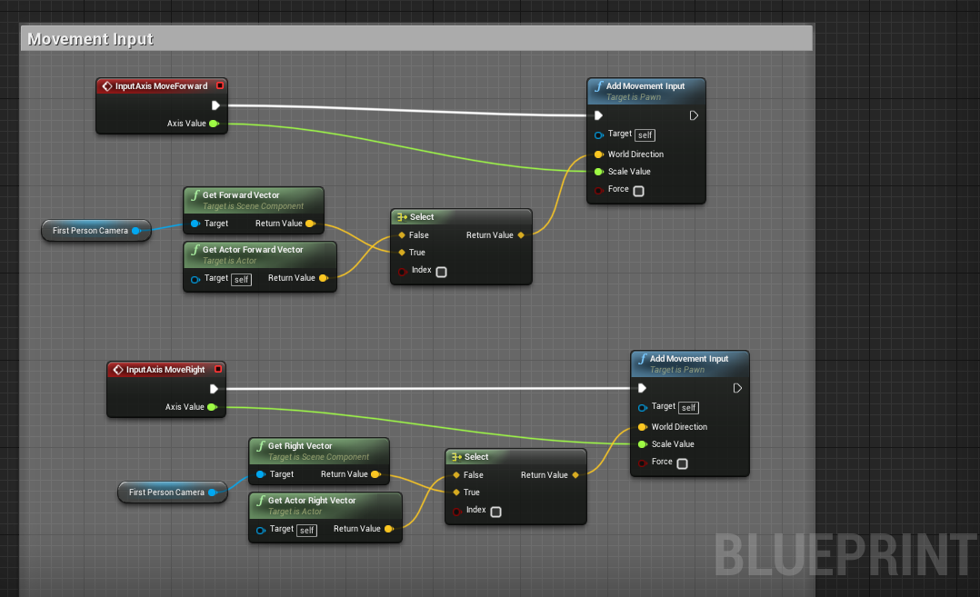
Player movement blueprint

Slide 6
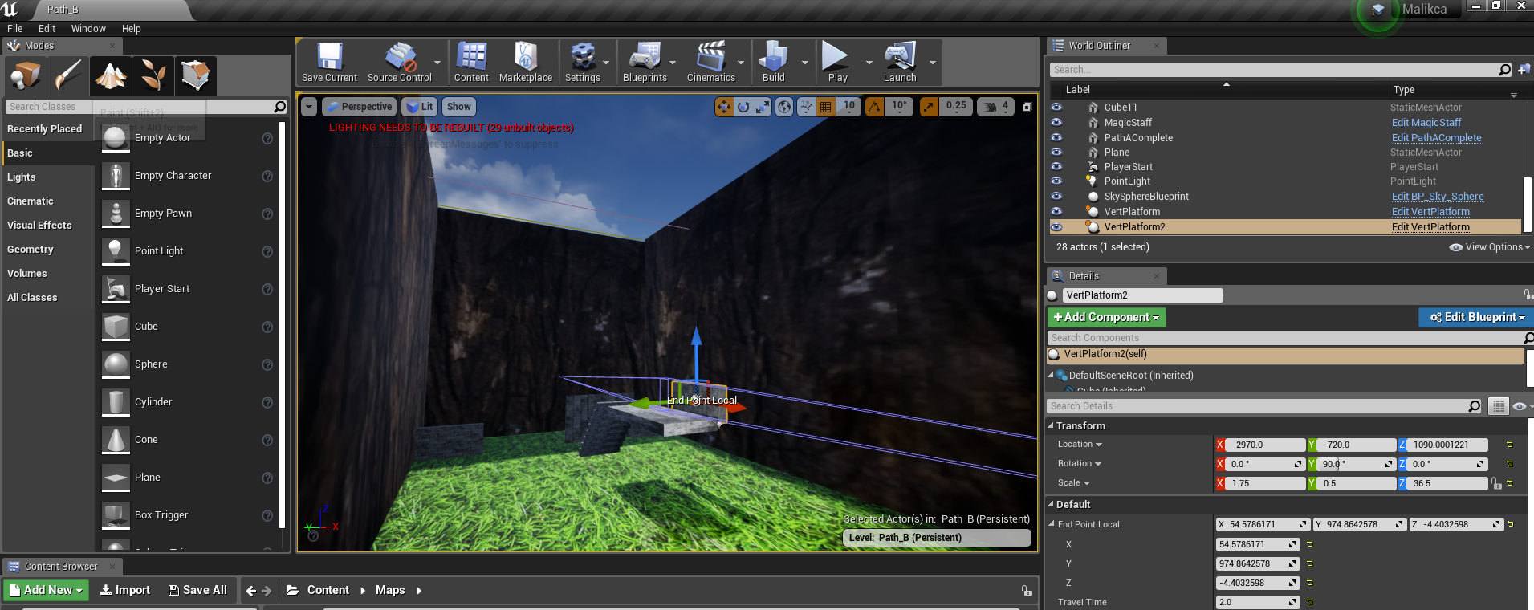
Level 2 in the editor

Slide 7
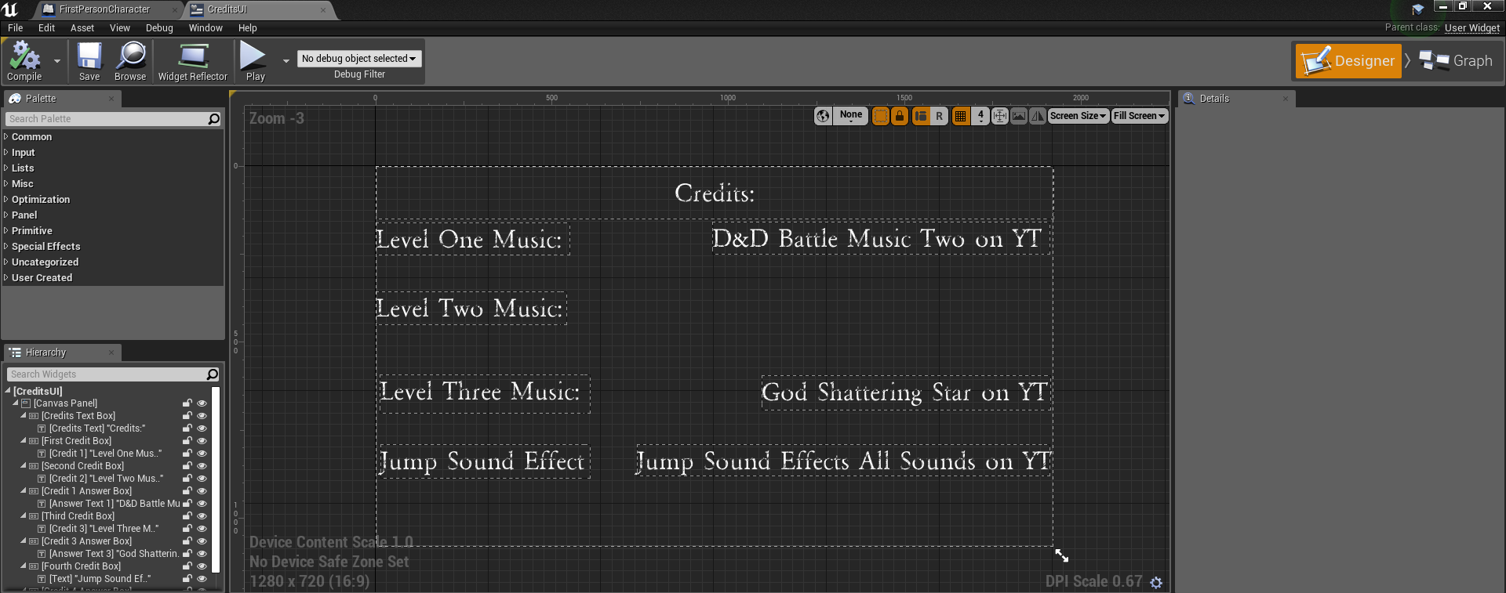
UI overlay in the editor

Slide 8
Post mortem
Things that went right:
-Assets (Music, SoundFX, Textures)
-Level Design
-The ability to win the game
Things that went wrong (or could have been better)
-Original idea was the have a hub and let the players choose what level to play
-Quality of textures and efficiency of material making from them
-Difficulty didn’t feel that scalable

Slide 9
“It’s an experience after all”
I learned few things from working on this capstone
-How to better organize my tasks and work flow
-Making games in Unreal compatible and accessible on all platforms
-To better manage time and stick to schedules
I tend to work on polish this game up even more, so that it becomes something I want on my portfolio
I hope future employers and game developers see this game and take an interest in my skills

Slide 10
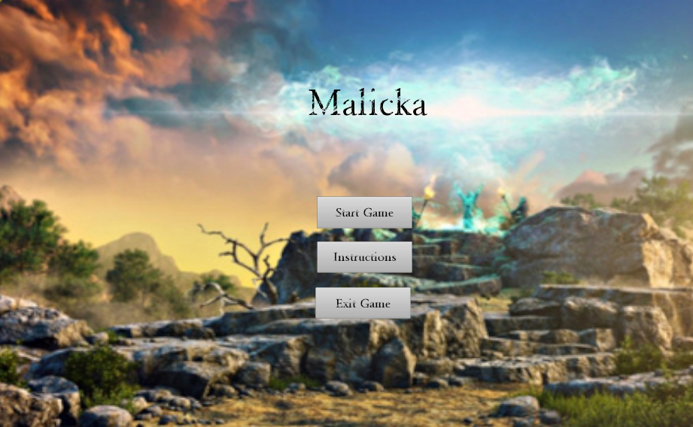
in the end…..
I had fun!

Slide 11
So……….
Questions?...
Thoughts?...
Concerns?...

